Slide 1
RAMALingam FOODS
TEAM ACES
Beena Mardi
Kshitij Vishwakarma
Priyanka Mandal
Rajiv Tanwar
Varun Kolhe

Slide 2
Case understanding
Mr. Ramalingam Venkatesh started the venture in the form of a fast-food restaurant in South Bombay in 1965.
During 1975 emergency imposed in the country, Ramalingam Foods started selling Idli-Dosa batters and South Indian Chutney packets.
Later they introduced different variants of Instant Mix in a powdered form with increased shelf life.
Currently Ramalingam food's operating revenues INR 152 crore for the financial year ending on 31 March 2019
It's EBITDA has increased by 3.16 % over the previous year. At the same time, it's book net worth has increased by 20 %
Recently there has been a demand for their products in the foreign market
Business expansion in international market.

Slide 3
Problem
The business expansion could have been done I
Middle east, Southeast Asian countries and England but due to limited budget Ramalingam Foods must go ahead with one region. Various factors are taken into consideration before making the final decision to expand the business in Southeast Asia.

Slide 4
solution
For the international expansion of Ramalingam Foods, our consultancy shortlisted Southeast Asia based on various factors which would make this a successful expansion. We would be targeting Malaysia and Singapore in FY 2019-20 due to presence of huge Indian population willing to buy these products. We have produced a marketing strategy and financial budgeting to launch all the existing products of the company. We would be having an organizational structure in Southeast Asia region Unit which would differ from that of India, initially and as per the company’s growth in the foreign market further changes would be imposed. We would also be expanding the Research and Development team to produce new dishes or to incorporate local taste of Southeast Asia in the products based on the market research. The company’s expansion would be backed up by an excellent IT team to manage the IT infrastructure and cope up with the changing digital market and a HR team to provide the best to the company employees.
CC BY-NC-ND

Slide 5
Mode of entry
Ramalingam foods will be exporting its products to Malaysia & Singapore
Local Distributers and retailers
Government Tie-ups
Government of the country
Government Linked Companies (GLC)
Non-government Sectors
Local Vendors
E-commerce platforms and Online Grocery delivery start-ups
Tesco
Happyfresh
Amazonfresh
Grabmart
Signature Market

Slide 6
Marketing Overview
Target population calculation
Target Audience estimation
Sub divided the audience into native and Indian citizens
Total Estimated audience is 171815
Sales Guestimates
Estimated sale for the year is 602559 units
Analysis of marketing trends and foreign market culture
Traditional trends like tasting centers
New upcoming trends like increasing health awareness among the consumers
Market penetration methods
Promotional Activities

Slide 7
Target Audience Estimation
Name | Total Population | Percentage % (Number of Indians) | Penetration per market | Target Audience
Malaysia | 32400000 | 9.35% (3029400) | - | -
Tamil | 2423520 | 80% of Indians | 0.02 | 48471
Other Indians | 605880 | - | 0.018 | 10906
Singapore | 5690000 | 8%(455200) | - | -
Tamil | 213944 | 47% of Indians | 0.02 | 4279
Other Indians | 241256 | - | 0.018 | 4343
Total (Indian Demand) |  |  |  | 67998
Other Malaysians | 29370600 | - | 0.003 | 88112
Other Singaporeans | 5234800 | - | 0.003 | 15704
Total Demand | - | - | - | 171815

Slide 8
Sales estimation
Products | Malaysia(units) | Singapore(units) | Total(units)
Dosa Mix | 82830 | 12997 | 95827
Chutney Mix | 94023 | 14615 | 108638
Dessert Mix | 87192 | 14723 | 101915
North Indian Mix | 54001 | 9680 | 63681
Instant Coffee | 137492 | 95006 | 232497
Total | 455538 | 147021 | 602559

Slide 9
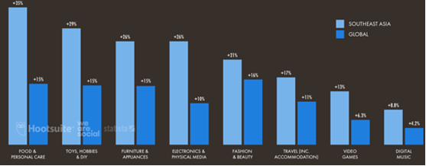
Promotional Activities
Trends in Southeast Asia
Campaign Supporting Health Awareness
Try-out stalls
Tasting Stations
Billboards and Handlers
Advertisements
Social Media Marketing

Slide 10
Marketing Budget Allocation
 | INR (Cr)
Available Budget | 10
Activities
Try outs | 2.5
Billboards and handlers | 1.5
Health Awareness campaigns | 1.5
Total | 5.5
Ads
TV & Radio | 2
Social Media Marketing | 1
Newspaper and Pamphlets | 1.5
Total | 4.5

Slide 11
FInancials
The allocation of budget among different departments is required to provide operational efficiency to all the departments
Budget Allocation (Crores)
HR |  | 7.00
IT |  | 6.00
Marketing |  | 10.00
Research & Development |  | 10.00
Export Activties |  | 8.00
Operational Expenditure |  | 6.50
Emergency Funds |  | 2.50
 |  | 50.00

Slide 12
Revenue Projections
Revenue Projections Year 2019-20 |  |  |  |  |  |  |  | Revenue Projections Year 2019-20
 |  | Demand |  |  | Revenue |  |  |  |  | Demand |  |  | Revenue
Items |  | Malaysia | Singapore | Average Price | Malaysia | Singapore |  | Items |  | Malaysia | Singapore | Average Price | Malaysia | Singapore
South Indian Mix |  | 82830 | 12997 | ₹ 297.82 | ₹ 2,46,68,722.94 | ₹ 38,70,812.41 |  | South Indian Mix |  | 86971.5 | 13646.85 | ₹ 297.82 | ₹ 2,59,02,159.09 | ₹ 40,64,353.03
Chutney mix |  | 94023 | 14615 | ₹ 260.88 | ₹ 2,45,28,941.47 | ₹ 38,12,795.59 |  | Chutney mix |  | 98724.15 | 15345.75 | ₹ 260.88 | ₹ 2,57,55,388.54 | ₹ 40,03,435.37
Dessert Mix |  | 87192 | 14723 | ₹ 379.71 | ₹ 3,31,07,315.29 | ₹ 55,90,409.71 |  | Dessert Mix |  | 91551.6 | 15459.15 | ₹ 379.71 | ₹ 3,47,62,681.06 | ₹ 58,69,930.19
North Indian Mix |  | 54001 | 9680 | ₹ 297.82 | ₹ 1,60,82,768.41 | ₹ 28,82,931.76 |  | North Indian Mix |  | 56701.05 | 10164 | ₹ 297.82 | ₹ 1,68,86,906.83 | ₹ 30,27,078.35
Instant Coffee |  | 137492 | 95006 | ₹ 149.00 | ₹ 2,04,86,308.00 | ₹ 1,41,55,894.00 |  | Instant Coffee |  | 144366.6 | 99756.3 | ₹ 149.00 | ₹ 2,15,10,623.40 | ₹ 1,48,63,688.70
 |  |  |  |  | ₹ 11,88,74,056.12 | ₹ 3,03,12,843.47 |  |  |  |  |  |  | ₹ 12,48,17,758.92 | ₹ 3,18,28,485.64
 |  |  |  |  | ₹ 14,91,86,899.59 |  |  |  |  |  |  |  | ₹ 15,66,46,244.57

Slide 13
SINGAPORE
MALAYSIA
HUMAN RESOURCES
In Singapore companies, talent
recruitment, staff loyalty and
performance motivation have always
been vital. Employee share incentive
plans serve as important tools for
industrial engineering businesses to
achieve these objectives, by
providing employees with long-term
rewards linked to the businesses’
success. There are three employee
share incentive plans commonly put
in place by companies in Singapore,
namely:
•Employee Share Option Plan
•Employee Share Awards Plan, and
•Phantom Share Option Plan
The result of company's experiment indicates that most Malaysian companies are influencing employees’ behaviors by linking the reward system and the company’s objectives. Reward system is the main tool to drive employees’ performance.
Hiring in Malaysia could be expensive as there are unavoidable cost and employer has to bear and since our company is hiring in foreign country additional expenses involved in expanding to the country. Some of the cost would include:
•Company registration
•Legal assistance
•Recruitment fees
•Translator
•Background checks

Slide 14
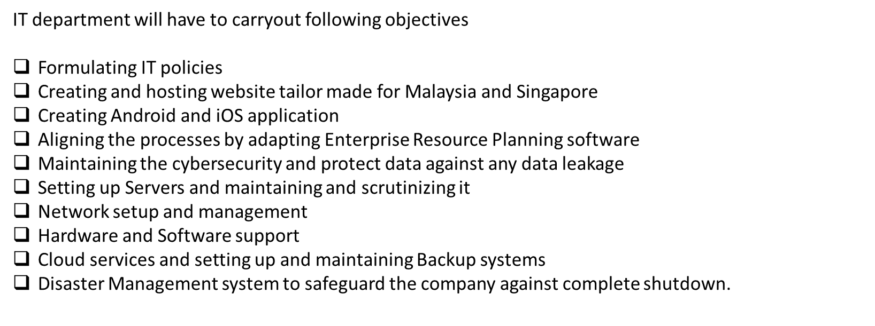
IT & Analytics Department

Slide 15
IT-Employee Policy
IT department will play a key role in setting up IT user policy for the employees to safeguard the user privacy and data in the company and make sure that the data of any sort generated inside the company facility doesn’t leave the facility.Some key policies will be
Security incident response policy
Data encryption policy
Mobile device security policy
Disaster recovery policy and business continuity plan
Creating Website
In today’s world, no company can survive without an online presence. The IT department will create the website, especially for Singapore and Malaysia. The website will primarily be hosted in English, but there will be an option to convert them to the regional language. The website will showcase the company address, products offered, e-commerce, chatbots, and customer care information.
Creating Android & iOS application
No company can sustain the competition without having a well-dedicated app that will enable recurring users to buy products from our platform and enjoy certain loyalty rewards. The app will be created for android and iOS users

Slide 16
Social Media handles (technical aspect)
The IT department will look after the technicalities revolving around the social media handles regarding their privacy and security. The analytics sub-department will also look after the social media handle insights provided by the social media platforms.
ERP- Enterprise Resource Planning
There should be a high degree of integration among the system and processes. We need to align the strategy such as order reception, stock check, inventory management, financials, sales, HR, etc.; for this, we need to subscribe to an ERP module, most probably SAP. IT will help to streamline all other processes and support the Analytics department with various data sets.
Cyber security
Cybersecurity is a significant issue in the business world today. Businesses today are vulnerable to cyber-attacks, no matter how big or how small the company is. We will enable devices such as a black box to safeguard the data and install antivirus and anti-ransomware (e.g., Sophos Intercept X) software.
Server system
IT department will try to create a dedicated server room with a server expert whose work will revolve around setting up a server, managing it, troubleshooting, setting up email exchange services, putting up a firewall

Slide 17
IT Communication
Since the Main Headquarters will be in India, there has to be an accommodation so that people can communicate with each other and there will be a smooth flow of information. For that, we will be setting up tools for Video conferencing and various VOIP devices
Networking setup
The main task of the IT department will be setting up the internal computer network with the help of the server and trying to integrate the desktops and laptops to ease the information transfer.
Hardware & Software support
All the hardware up-gradation and changes will be facilitated through the IT department who will procure the hardware and set it up. All Software licensing, upgrade, and the IT department will look after surveillance. After that, the installation and troubleshooting will be seen over by trained IT professionals.
Cloud Service and backup system
There should be a certain level of collaboration between the employees working overseas and in home ground. This can be achieved by using a cloud service. All files and data can be organized and easily shared among both organizations.

Slide 18
ANALYTICS TEAM
The analytics team will perform the following
Integrating Deep learning tech
HR analytics
Demand forecasting
Hyper localization
Logistics monitoring
AI enabling
ML integration
Customer Feedback Analysis
Chatbot operations
To set up this entire facility, the max allocation done to the IT department by
the Finance department is 6 CR out of 50 CR budget.

Slide 19
Thanks

